Slide 1
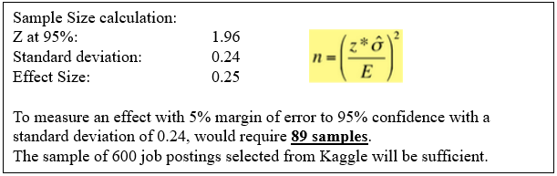
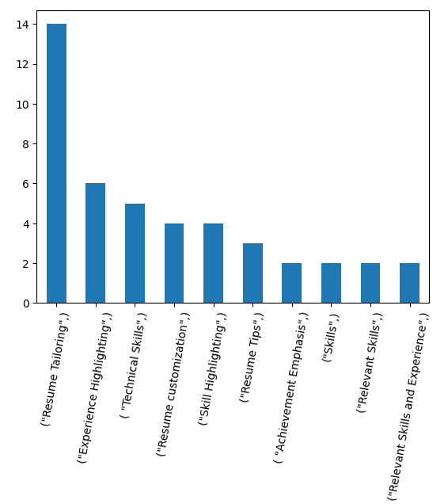
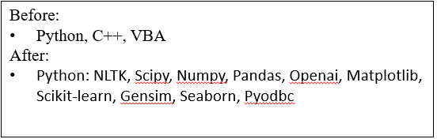

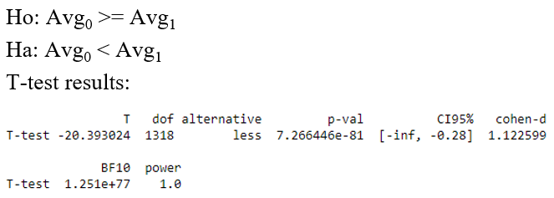
Process Improvement Project – Cycle Time Reduction
Process owner: Toby Anderson
Key Dates --->
Team Launch
4/23
Define
4/28
Measure
5/20
Analyze
5/28
Improve
6/3
Control
Ongoing
DEFINE
MEASURE
ANALYZE
IMPROVE
Over 600 job postings were collected, including Salary and location.
Aggregated focused feedback by comparing the resume’s to multiple job postings.
Professional summary was generated, and technical details were expanded greatly with more specific tools and modules used.
Be specific with technical skills!
Problem Statement:
Data Science roles and responsibilities are not well defined or standardized. The industry jargon changes rapidly, leading to a difficult job market to navigate.
Business Impact:
Current resume does not match the majority of Data Science job postings, and is unlikely to get selected for an interview.
Pareto Feedback Insights
More samples than needed
Sigma Quality Level improved by 1.45
Each iteration of the resume was graded independently against each job posting. Baseline resume has 19% chance of an interview.
CONTROL
Improvements tested as hypotheses.
Control Plan:
Re-use validation tools.
Incrementally improve baseline resume.
Reverse match job postings.
Kappa used to verify consistency of rating.
Automated Scoring System
Flexible tools can be re-used!
PROJECT TEAM: Toby Anderson

Slide 2
Define
Goal and Methods
The goal of this project is to improve my resume’s fit to Data Science job positions, which will increase my chances of getting interviews when applying. I’ll consider the project a success if the average match increases from 25% to 50% chance of an interview.
The inputs will be a series of Data Science job posting texts, and different improved versions of my resume. Multiple reviewers will judge the fit of the resume to the job description, and rate the probability that the resume is selected for an interview on a discrete scale: Remote, Unlikely, Moderate, Probable, or Certain. A Kappa score will be used to ensure reviewer consistency.
Process Description
My current process for applying to job positions:
Begin with my previous Resume as a baseline.
Read the job requirements.
Highlight relevant experience.
Remove unrelated skills and experience.
To improve this process, I need to investigate multiple aspects of my resume that can be improved to create a higher quality “baseline” resume that is easier to adjust to new positions. Additionally, I can investigate more methods of adjusting my resume outside of adding and removing specific content, such as improving the style, or using the appropriate industry terms.

Slide 3

Measure: Data Measurement Plan
Process Questions | Data Source Location | How will Data be Collected
What are typical Data Science job descriptions? | A sample of over 600 job postings is available on Kaggle: https://www.kaggle.com/datasets/rashikrahmanpritom/data-science-job-posting-on-glassdoor | The CSV will be downloaded and processed in a Python Jupyter notebook.
How do different versions of my resume perform against Data Science job postings? | Ratings from third-party resume reviewers. | Engineering a prompt for the OpenAI API interface, which will judge the fit of the resume to each job posting.
What feedback can I use to improve my resume? | Advice and feedback from third-party reviewers. | Feedback will be sampled from OpenAI, then categorized and summarized for review.
The desired effect size (ES) is an increase of 25% probability of an interview on average with a 95% confidence and a 5% margin of error.
Although the data will be collected from a discrete scale, it will be converted to a set of probabilities and processed as continuous data:
Remote: 0%
Unlikely: 25%
Moderate: 50%
Probable: 75%
Certain: 100%
Sample Size calculation:
Z at 95%: 1.96
Standard deviation: 0.24
Effect Size: 0.25
To measure an effect with 5% margin of error to 95% confidence with a standard deviation of 0.24, would require 89 samples.
The sample of 600 job postings selected from Kaggle will be sufficient.

Slide 4
Analyze: Pareto Chart
The following prompt was used with the OpenAI API to solicit focused feedback on each job posting.
“ Using all the knowledge of a hiring manager and senior data analyst, you provide constructive feedback to improve a resume's chances of being selected for a job. Based on the resume and job description below, provide a three point list of the most important advice to improve the resume's chances of being selected for an interview.”
The advice was categorized. The results of the categorization is shown in the pareto chart.
Results: While “Resume Tailoring” and “Resume Customization” is not advice that can be generalized to improve a baseline resume, several of the advice categories suggest highlighting more technical skills. So I can go into more detail in the technical skills section of my resume.

Slide 5
Analyze: Scoring Kappa
Since the primary measure of resume scores relies on third-party scoring, I need to verify that the results are reproducible to ensure that I can trust the scoring system.
To achieve this, I rated the same resume twice against all 600 job postings, and used the results to measure a Kappa score.
With a Kappa score above 0.6, this will tell me that the scoring method is consistent and reproducible.
The formula for the Kappa score:
Using a threshold of 0.5, the data was converted to Yes/No selection from each annotator.
Kappa Score Result:
0.59
This indicates a moderate level of agreement between annotators. Although the level of agreement is not strong, this is mitigated by having an oversized sample of 600 job postings.

Slide 6

Analyze: Hypothesis Testing
Based on the pareto chart of feedback, one good approach to improving my baseline resume will be to expand on specific technical skills. To do this, for each programming language I’m familiar with, I will list the modules and techniques that I’ve used in the language. If this is indeed the most important change to my resume, I would expect at least a 15% increase in the average probability of being interviewed.
To test this hypothesis, I will measure scores before and after the implementation.
Example change below.
Ho: Avg₀ >= Avg₁
Ha: Avg₀ < Avg₁
T-test results:
With a very low p-value (approx. 0), we are sure that the new resume has an increase in score. The 95% confidence interval is between a [28%, inf%) increase in score, which gives at least an increase of 28% with statistical significance.
The measured average changes are below:
Avg₀:19%
Avg₁:51%
Before:
Python, C++, VBA
After:
Python: NLTK, Scipy, Numpy, Pandas, Openai, Matplotlib, Scikit-learn, Gensim, Seaborn, Pyodbc

Slide 7
Analyze: SQL
I’ve defined a success as >=50% chance of an interview, and a failure as <50% chance of an interview.
Based on this definition, the yields have been calculated between three versions of my resume and presented below.
Resume | Yield % | SQL
Original Resume | 16.8% | 0.55
Resume with expanded technical details | 47.4% | 1.45
Resume with technical details and professional summary. | 66% | 1.9
Between the original and final resume, the Sigma Quality Level was increased by 1.45 units.

Slide 8
Improve: Summary of Changes
Improvements | Description
Technical Skills – Be specific! | Based on the aggregated focused feedback, the primary change made to my resume was to go into specific details in technical skills. Keeping technical skills vague was decreasing the match to job postings which were searching for specific skills.
Professional Summary – Bottom Line Up Front! | Additionally, based on a qualitative analysis of the feedback, I added a professional summary section, with the intent to communicate competence and experience quickly to hiring managers who might skim my resume.
These changes more than doubled my chances of getting an interview for a data science job, as seen on slide 6.
With an average chance of an interview increased to 51%, the project goals have been successfully met.

Slide 9
Control: Holding the Gains
My plan for holding the gains has three parts:
Re-usable tools: The code written for this project is highly re-usable. By feeding it updated lists of job postings with my current resume, I can get continual feedback for improvements.
Baseline resume: The baseline resume can be continually improved based on focused feedback, then tweaked or customized for specific positions when needed.
Reverse match: In the future, I can scrape job websites for postings, and find jobs that match my baseline resume using similar methods. Then I can focus on applying to those positions.

